Slide 1

TO: DANIEL WEBSTER COLLEGE

Slide 2
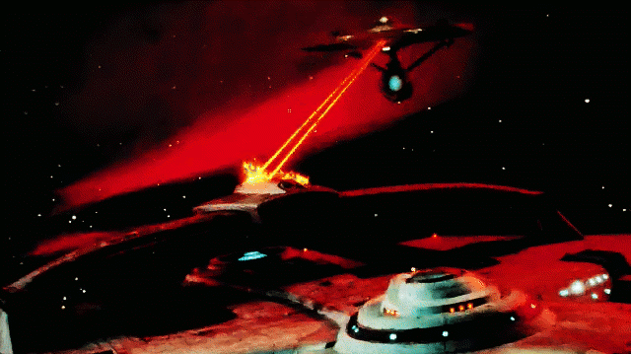
Battle Starships
Proposal by
Chris Amarello
Ryan Flaherty
Jing Ming

Slide 3
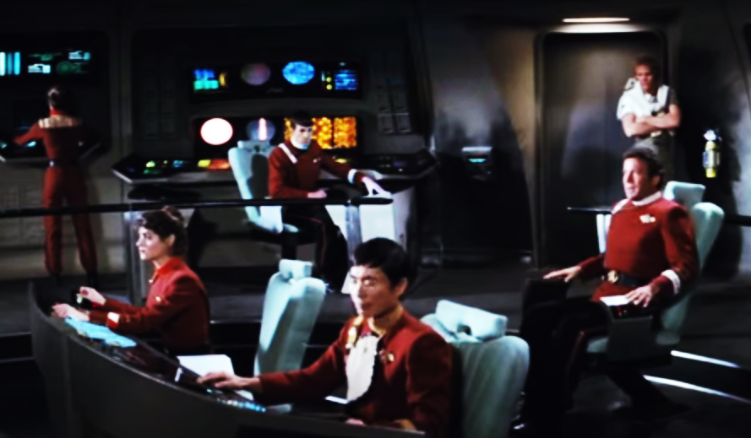
Roles
Chief Programmers
Ryan Flaherty
Jing Mingh
Artistic Programmer
Chris Amarello

Slide 4
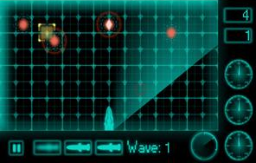
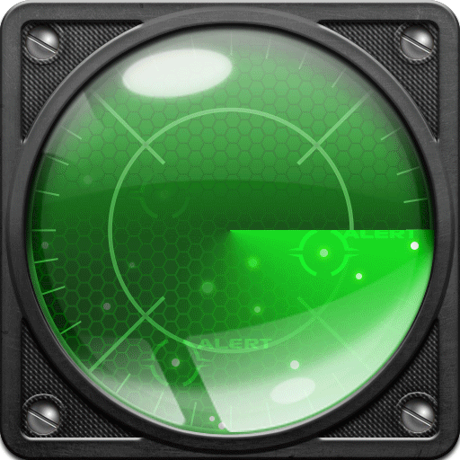
Core Mechanics & Rules
Player Vs. A.I.
Position starship armada on Placement Grid
Fog of War - Unable to see the other player positions
Click on enemy Tactical Grid to fire
Miss – Turn is over
Hit – Damage other enemy ship and turn is over
Win - Destroy the other entire enemy armada
Lose - Your own armada is destroyed!

Slide 5
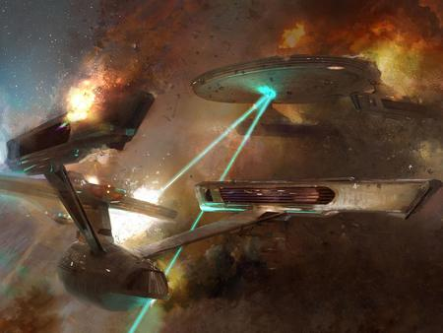
Primary Goals (Timeline)
Create simple base game
Tactical Grid (array)
Ship Placement Grid (array)
Ships & Ship Placement
Attacking (Hit & Miss)
User Interface
Enemy A.I. (Simple)
Classes
Track state of cell on grid (Hit & Miss)
Taking Turns

Slide 6
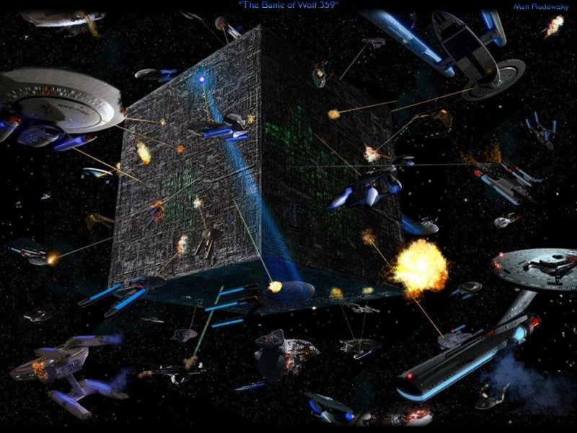
Stretch Goals (Enhancements)
Shield Barriers
AoE attacks (Area of Effect)
Starship repair mods (Restore HP)
Black hole generators
Starfighters
Soundtrack
Starship Movement
Advance A.I. sub-classes

